Slide 1

Connection Management System
Instructor : Eric Heilig
Student : Andy Le

Slide 2
Overview
General information Connection Management System
Database Diagram
Introduction some main pages in web application
Run demo
Questions & Answers

Slide 3
Connection Management System
Project Description
My project is to build a website system that allows users to create events to connect with other users on the internet. The system allows website visitors to view all events created by registered users. But they cannot register to attend if they are not a registered member with an account on the system.
Summary of Pages
Home Page contains links for user-specific navigation such as login, signup,... The main content area provides an introduction and overview of the site.
User Profile: contains information about the events created by that user and the RSVP that the user chose.
Connections Page: provide all of the connections/events created by other users. Each category contains at least one connection/event.
Connection Detail: provide the description of a detailed connection, such as category/topic, host user name, time date, location.
New Connection: allow users to create a new connection.
(next page keep introducing about pages in this system)

Slide 4
Connection Management System (continue…)
Summary of Pages
Login page: allows users to log in to the site
Signup Page: This allows users to create a new account for the site’s members to get permission to create, update their own connections.
Search Page: allow the user to search the connection/event based on the name of the event and the categories list of events
About Page: provide the visitors with some information about the site.
Contact Page: provide the contact information
Admin Page: allow the administrators to maintain the site’s members such as update, delete the members.

Slide 5
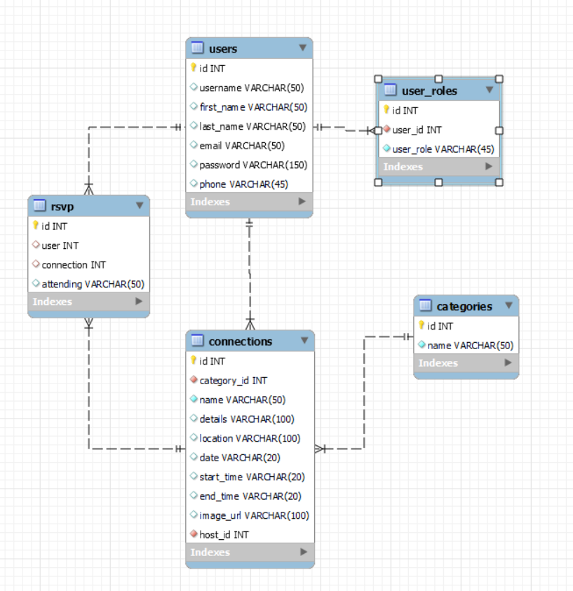
Database Diagram

Slide 6
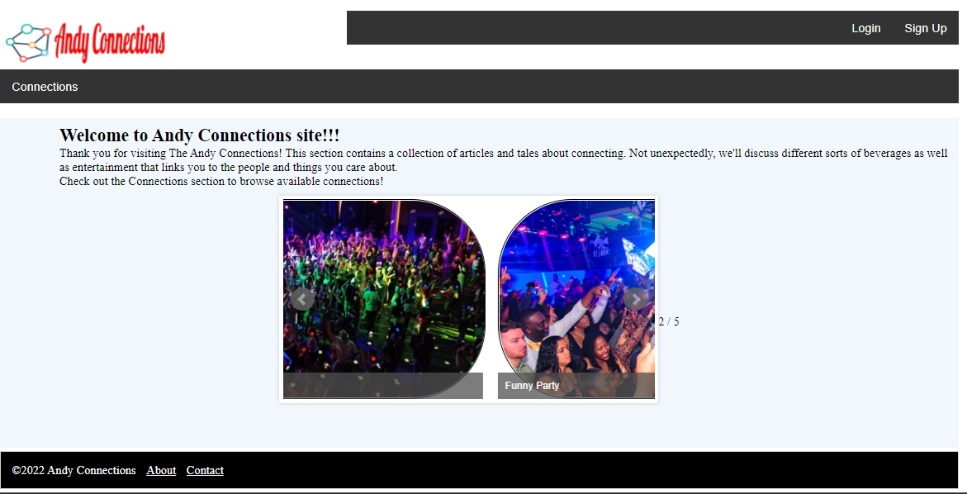
Main pages - Home page

Slide 7
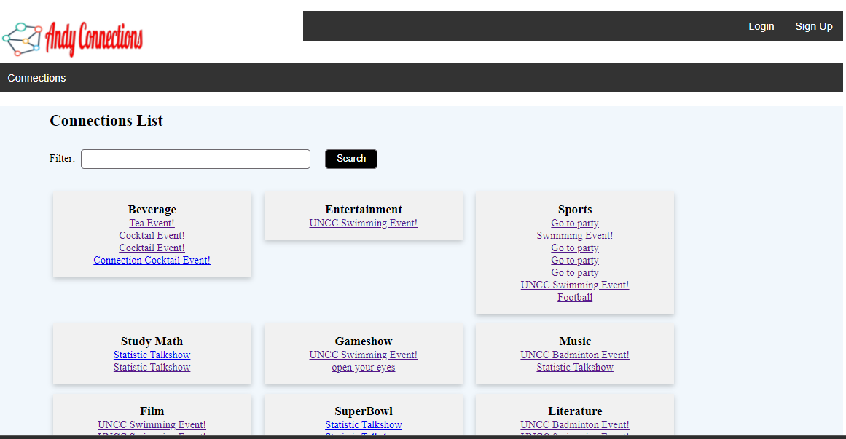
Main pages - Connection List

Slide 8
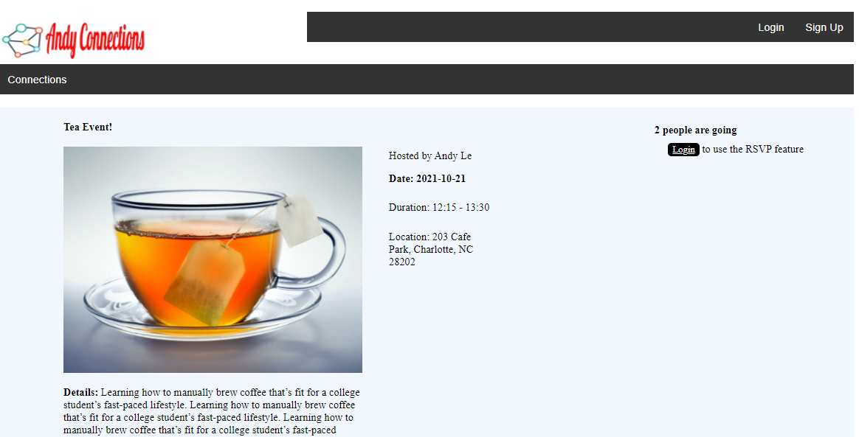
Main pages - Connection

Slide 9
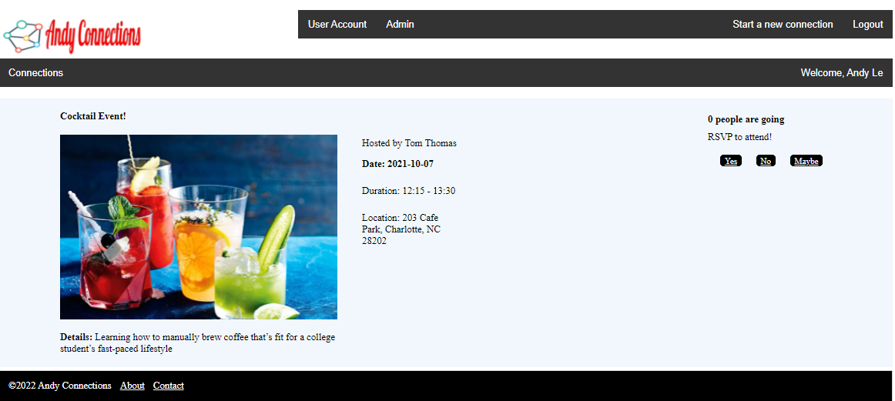
Main pages - RSVP

Slide 10
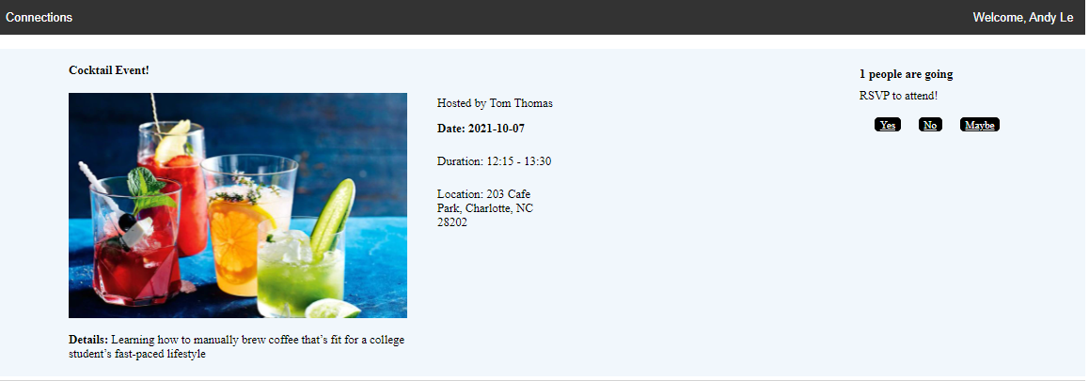
Main pages - RSVP
after the logging user click yes to attend this event

Slide 11
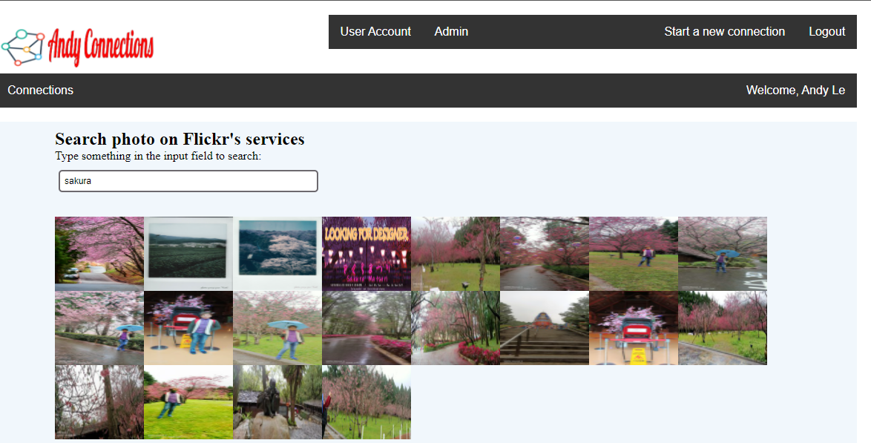
Search photo on Flickr’s service
Using Javascript & Ajax & Json & Jquery

Slide 12
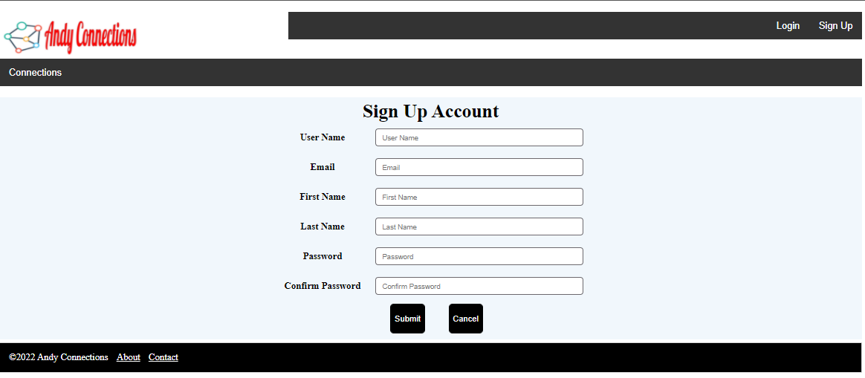
Main pages - Sign Up Account

Slide 13
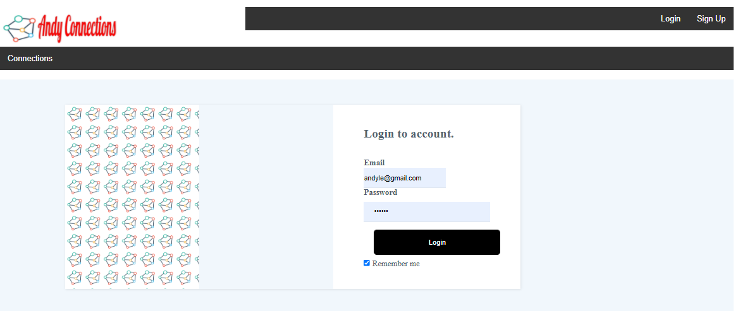
Main pages - Login

Slide 14
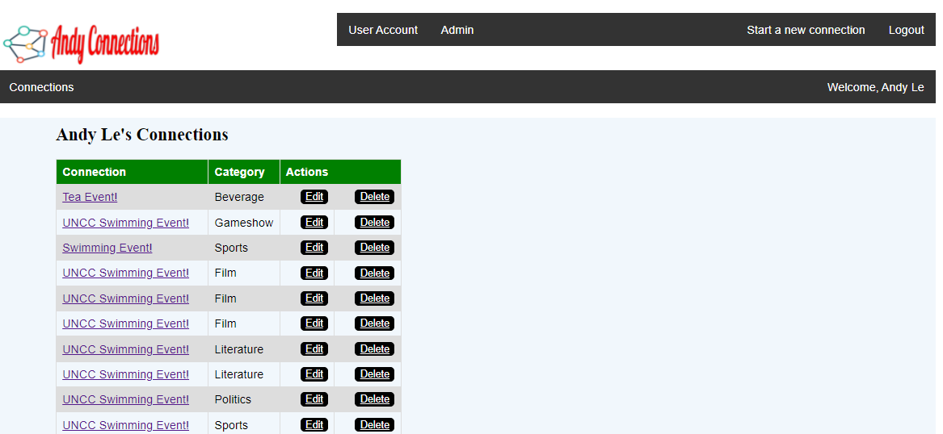
Main pages - User Profile

Slide 15
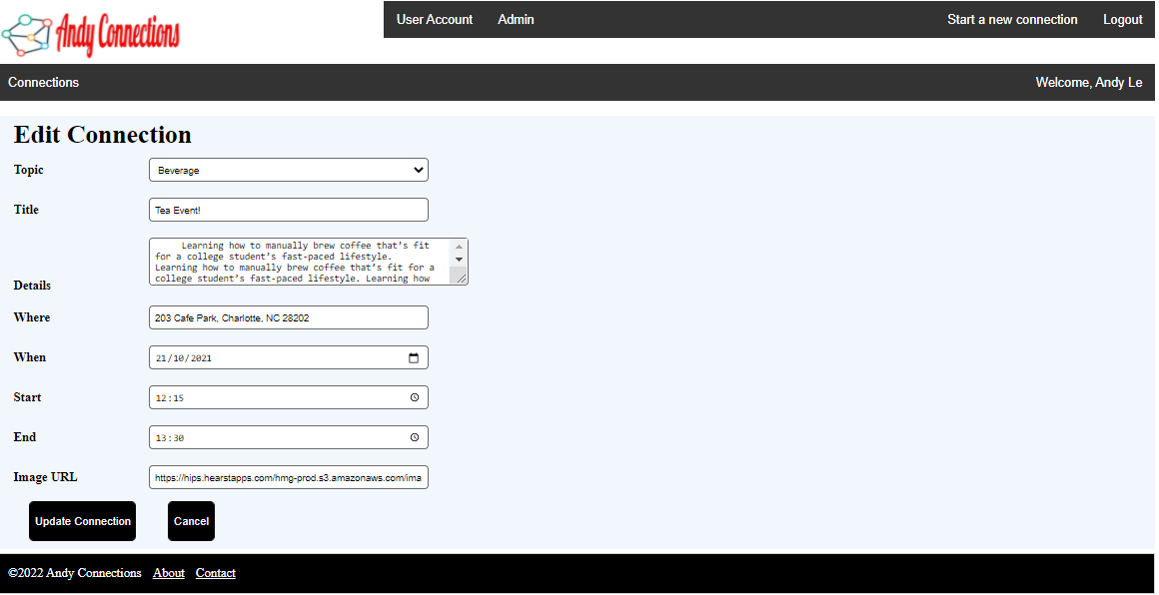
Main pages - Edit Connection

Slide 16
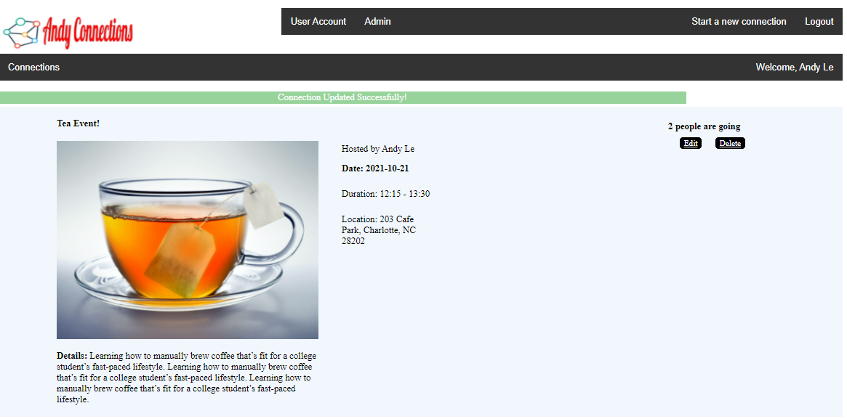
Main pages - Updated Connection

Slide 17
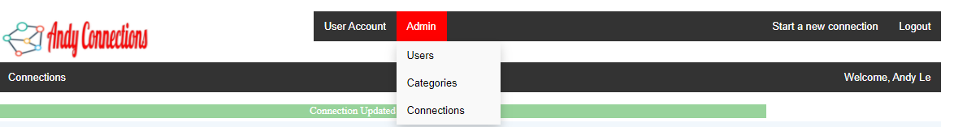
Main pages - Admin Menu

Slide 18
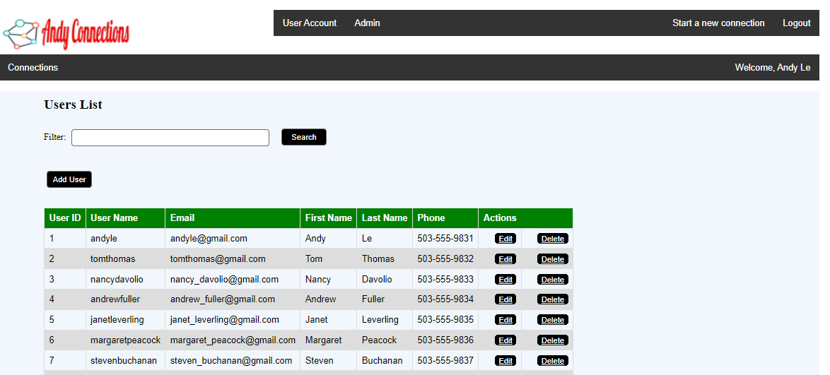
Admin - User Maintenance

Slide 19
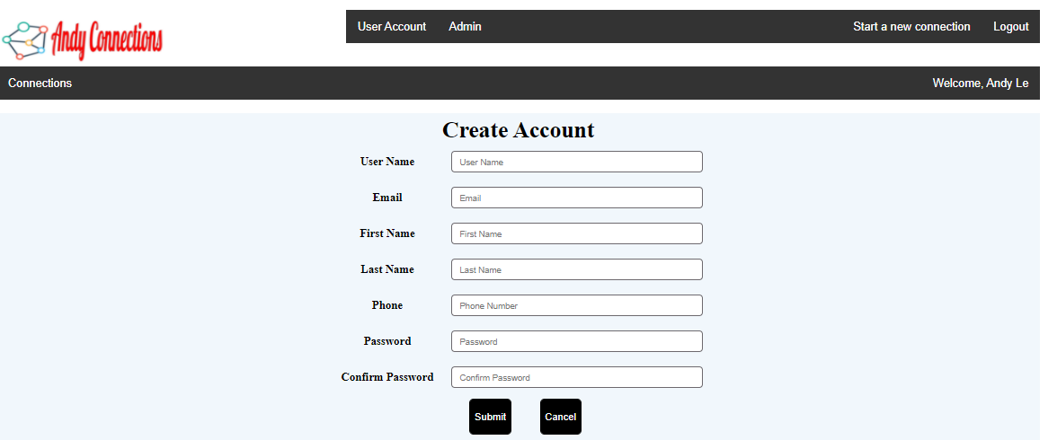
Admin - Create User Account

Slide 20
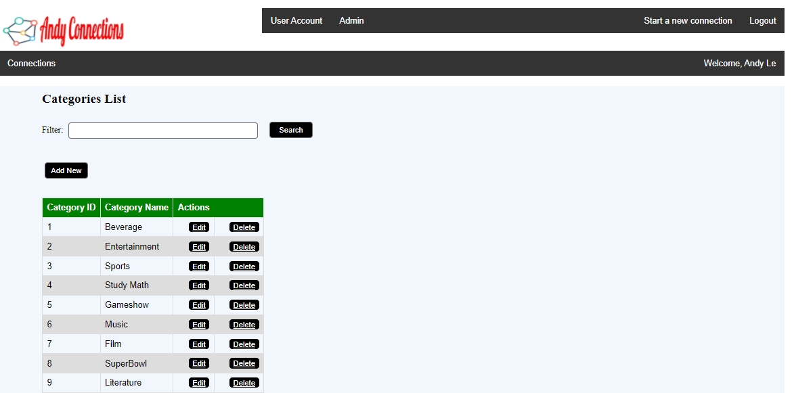
Admin - Categories Maintenance

Slide 21
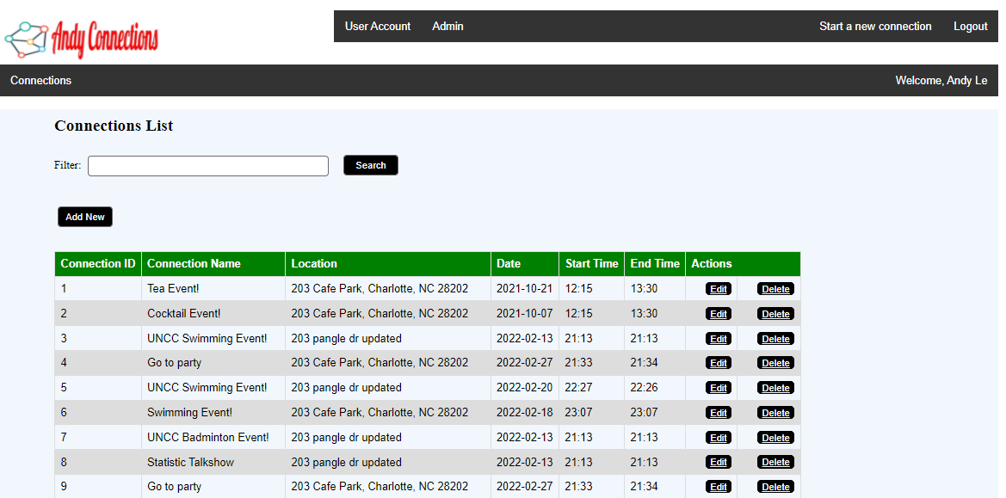
Admin - Connections Maintenance

Slide 22
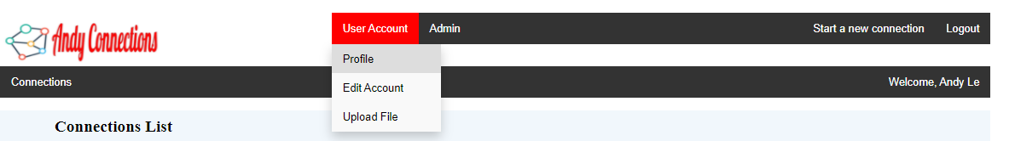
User Account Menu

Slide 23
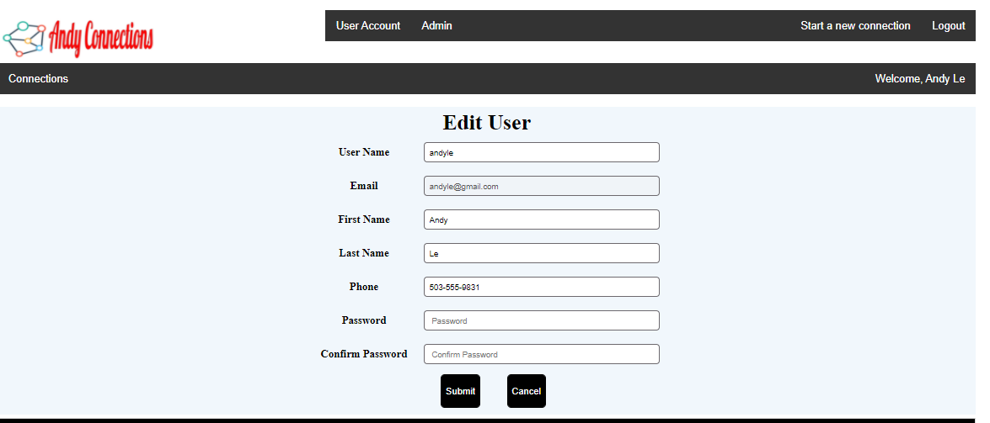
User Account - Edit User Information

Slide 24
Run demo
Start the Tomcat Server
Start the MySQL workbench
Prepare some demo data
Browse the localhost:8080

Slide 25

Questions & Answers

Slide 26

Thank you

